Slide 1
Backend - Components
Pravin Y Pawar

Slide 2
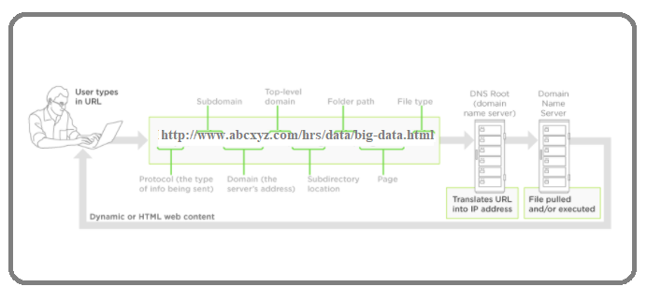
Server side Components
Servers: The machinery
Server acts as the lifeblood of the network
Can be on-site or in the cloud
High-powered computers provide shared resources that need to run for application
file storage
security and encryption
databases
email
web services
Image : Adapted from Upwork

Slide 3
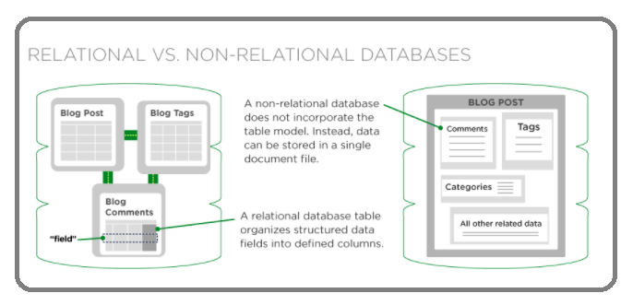
Server side Components
Databases: The brains
Are the brains that make websites dynamic
Is responsible for accepting that query, fetching the data, and returning it to the website
Searching for a product in on online store
Searching for hotel locations within a specific state
Accepts new and edited data when users of a website or application interact with them
The client can change information in a database from the browser such as
posting articles to a CMS
uploading photos to a social media profile
updating their customer information
Image : Upwork

Slide 4
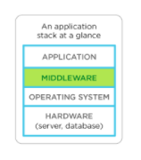
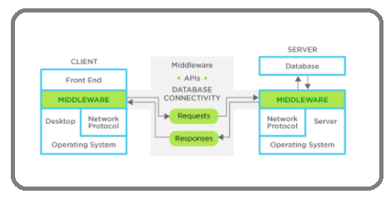
Server side Components
Middleware: The plumbing
Any software on the server that connects an application’s front end to its back end
Think of it as plumbing for your site
pipes any communication, like requests and responses, back and forth between your application and server/database
you don’t see middleware, but it’s there and it has to be reliable and always do what’s expected of it
Middleware (server-side software) facilitates client-server connectivity, forming a middle layer between the app(s) and the network
Can be multi-layered, organized into different layers of a site, whether it’s the presentation layer or the business layer
Web APIs can play into the stack, providing a bridge between the business layer and presentation layer
Image : Upwork

Slide 5
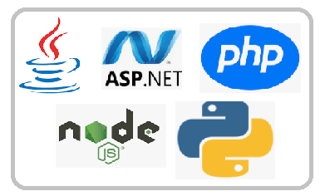
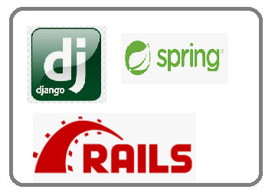
Server side Components
Programming languages & frameworks: The nuts & bolts
Can choose from a variety of languages and frameworks depending on
the type of application being built
the specific processing requirements
other components already exist on the back end
Languages will differ in file size, performance, compatibility, how many lines of code required, and the style of programming
Some back-end scripting languages are object-oriented programming languages
Other languages may be compiled rather than interpreted
affects load time, readability, and processing power required to run the application
Big hitters in back-end programming, like:
Java
C# and C++
.NET
Perl
Scala
Node.js
Frameworks that developers use as scaffolding to build server-side applications
Django (for Python)
Spring framework (for Java)
Node.js including MeteorJS and ExpressJS (for JavaScript with Node.js)
Ruby on Rails
Symfony (for PHP)

Slide 6
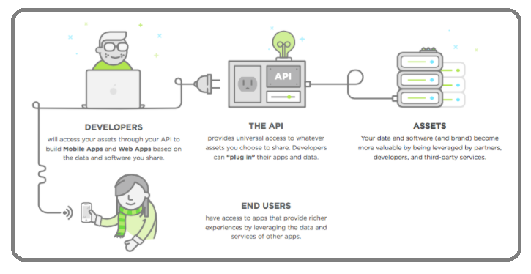
Server side Components
APIs: Crucial tech in Back-End programming
Can’t talk about the back-end portion of an application these days without touching on APIs (application programming interfaces)
Connect software, applications, databases, and services together seamlessly
Plays an integral role in how most server-side software architectures are built
Replacing more complicated programming to allow software to communicate and data to be transferred
Image : Upwork

Slide 7
Thank You!
In our next session:

